Slide 1
Algorithms for
Classification:
The Basic Methods

Slide 2
Outline
Simplicity first: 1R
Naïve Bayes

Slide 3
Classification
Task: Given a set of pre-classified examples, build a model or classifier to classify new cases.
Supervised learning: classes are known for the examples used to build the classifier.
A classifier can be a set of rules, a decision tree, a neural network, etc.
Typical applications: credit approval, direct marketing, fraud detection, medical diagnosis, …..

Slide 4

Simplicity first
Simple algorithms often work very well!
There are many kinds of simple structure, eg:
  One attribute does all the work
  All attributes contribute equally & independently
  A weighted linear combination might do
  Instance-based: use a few prototypes
  Use simple logical rules
Success of method depends on the domain
witten&eibe

Slide 5
Inferring rudimentary rules
1R: learns a 1-level decision tree
  I.e., rules that all test one particular attribute
Basic version
  One branch for each value
  Each branch assigns most frequent class
  Error rate: proportion of instances that don’t belong to the majority class of their corresponding branch
  Choose attribute with lowest error rate
(assumes nominal attributes)
witten&eibe

Slide 6
Pseudo-code for 1R
For each attribute, For each value of the attribute, make a rule as follows: count how often each class appears find the most frequent class make the rule assign that class to this attribute-value Calculate the error rate of the rules Choose the rules with the smallest error rate
Note: “missing” is treated as a separate attribute value
witten&eibe

Slide 7
Evaluating the weather attributes
Outlook | Temp | Humidity | Windy | Play
Sunny | Hot | High | False | No
Sunny | Hot | High | True | No
Overcast | Hot | High | False | Yes
Rainy | Mild | High | False | Yes
Rainy | Cool | Normal | False | Yes
Rainy | Cool | Normal | True | No
Overcast | Cool | Normal | True | Yes
Sunny | Mild | High | False | No
Sunny | Cool | Normal | False | Yes
Rainy | Mild | Normal | False | Yes
Sunny | Mild | Normal | True | Yes
Overcast | Mild | High | True | Yes
Overcast | Hot | Normal | False | Yes
Rainy | Mild | High | True | No
Attribute | Rules | Errors | Total errors
Outlook | Sunny → No | 2/5 | 4/14
 | Overcast → Yes | 0/4
 | Rainy → Yes | 2/5
Temp | Hot → No* | 2/4 | 5/14
 | Mild → Yes | 2/6
 | Cool → Yes | 1/4
Humidity | High → No | 3/7 | 4/14
 | Normal → Yes | 1/7
Windy | False → Yes | 2/8 | 5/14
 | True → No* | 3/6
* indicates a tie
witten&eibe

Slide 8
Dealing with numeric attributes
Discretize numeric attributes
Divide each attribute’s range into intervals
  Sort instances according to attribute’s values
  Place breakpoints where the class changes
  (the majority class)
  This minimizes the total error
Example: temperature from weather data
Outlook | Temperature | Humidity | Windy | Play
Sunny | 85 | 85 | False | No
Sunny | 80 | 90 | True | No
Overcast | 83 | 86 | False | Yes
Rainy | 75 | 80 | False | Yes
… | … | … | … | …
64 65 68 69 70 71 72 72 75 75 80 81 83 85 Yes | No | Yes Yes Yes | No No Yes | Yes Yes | No | Yes Yes | No
witten&eibe

Slide 9
The problem of overfitting
This procedure is very sensitive to noise
  One instance with an incorrect class label will probably produce a separate interval
Also: time stamp attribute will have zero errors
Simple solution:
enforce minimum number of instances in majority class per interval
witten&eibe

Slide 10
Discretization example
Example (with min = 3):
Final result for temperature attribute
64 65 68 69 70 71 72 72 75 75 80 81 83 85 Yes | No | Yes Yes Yes | No No Yes | Yes Yes | No | Yes Yes | No
64 65 68 69 70 71 72 72 75 75 80 81 83 85 Yes No Yes Yes Yes | No No Yes Yes Yes | No Yes Yes No
witten&eibe

Slide 11
With overfitting avoidance
Resulting rule set:
Attribute | Rules | Errors | Total errors
Outlook | Sunny → No | 2/5 | 4/14
 | Overcast → Yes | 0/4
 | Rainy → Yes | 2/5
Temperature | ≤ 77.5 → Yes | 3/10 | 5/14
 | > 77.5 → No* | 2/4
Humidity | ≤ 82.5 → Yes | 1/7 | 3/14
 | > 82.5 and ≤ 95.5 → No | 2/6
 | > 95.5 → Yes | 0/1
Windy | False → Yes | 2/8 | 5/14
 | True → No* | 3/6
witten&eibe

Slide 12

Discussion of 1R
1R was described in a paper by Holte (1993)
  Contains an experimental evaluation on 16 datasets (using cross-validation so that results were representative of performance on future data)
  Minimum number of instances was set to 6 after some experimentation
  1R’s simple rules performed not much worse than much more complex decision trees
Simplicity first pays off!
Very Simple Classification Rules Perform Well on Most Commonly Used Datasets
Robert C. Holte, Computer Science Department, University of Ottawa
witten&eibe

Slide 13
Bayesian (Statistical) modeling
“Opposite” of 1R: use all the attributes
Two assumptions: Attributes are
  equally important
  statistically independent (given the class value)
    I.e., knowing the value of one attribute says nothing about the value of another
    (if the class is known)
Independence assumption is almost never correct!
But … this scheme works well in practice
witten&eibe

Slide 14
Probabilities for weather data
Outlook |  |  | Temperature |  |  | Humidity |  |  | Windy |  |  | Play
 | Yes | No |  | Yes | No |  | Yes | No |  | Yes | No | Yes | No
Sunny | 2 | 3 | Hot | 2 | 2 | High | 3 | 4 | False | 6 | 2 | 9 | 5
Overcast | 4 | 0 | Mild | 4 | 2 | Normal | 6 | 1 | True | 3 | 3
Rainy | 3 | 2 | Cool | 3 | 1
Sunny | 2/9 | 3/5 | Hot | 2/9 | 2/5 | High | 3/9 | 4/5 | False | 6/9 | 2/5 | 9/14 | 5/14
Overcast | 4/9 | 0/5 | Mild | 4/9 | 2/5 | Normal | 6/9 | 1/5 | True | 3/9 | 3/5
Rainy | 3/9 | 2/5 | Cool | 3/9 | 1/5
Outlook | Temp | Humidity | Windy | Play
Sunny | Hot | High | False | No
Sunny | Hot | High | True | No
Overcast | Hot | High | False | Yes
Rainy | Mild | High | False | Yes
Rainy | Cool | Normal | False | Yes
Rainy | Cool | Normal | True | No
Overcast | Cool | Normal | True | Yes
Sunny | Mild | High | False | No
Sunny | Cool | Normal | False | Yes
Rainy | Mild | Normal | False | Yes
Sunny | Mild | Normal | True | Yes
Overcast | Mild | High | True | Yes
Overcast | Hot | Normal | False | Yes
Rainy | Mild | High | True | No
witten&eibe

Slide 15
Probabilities for weather data
Outlook |  |  | Temperature |  |  | Humidity |  |  | Windy |  |  | Play
 | Yes | No |  | Yes | No |  | Yes | No |  | Yes | No | Yes | No
Sunny | 2 | 3 | Hot | 2 | 2 | High | 3 | 4 | False | 6 | 2 | 9 | 5
Overcast | 4 | 0 | Mild | 4 | 2 | Normal | 6 | 1 | True | 3 | 3
Rainy | 3 | 2 | Cool | 3 | 1
Sunny | 2/9 | 3/5 | Hot | 2/9 | 2/5 | High | 3/9 | 4/5 | False | 6/9 | 2/5 | 9/14 | 5/14
Overcast | 4/9 | 0/5 | Mild | 4/9 | 2/5 | Normal | 6/9 | 1/5 | True | 3/9 | 3/5
Rainy | 3/9 | 2/5 | Cool | 3/9 | 1/5
Outlook | Temp. | Humidity | Windy | Play
Sunny | Cool | High | True | ?
A new day:
Likelihood of the two classes For “yes” = 2/9 × 3/9 × 3/9 × 3/9 × 9/14 = 0.0053 For “no” = 3/5 × 1/5 × 4/5 × 3/5 × 5/14 = 0.0206 Conversion into a probability by normalization: P(“yes”) = 0.0053 / (0.0053 + 0.0206) = 0.205 P(“no”) = 0.0206 / (0.0053 + 0.0206) = 0.795
witten&eibe

Slide 16
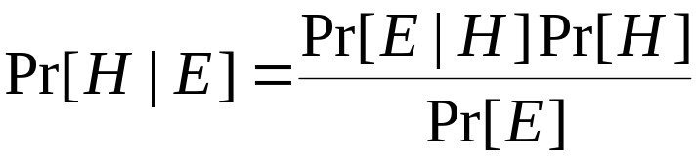


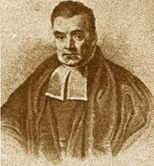
Bayes’s rule
Probability of event H given evidence E :
A priori probability of H :
  Probability of event before evidence is seen
A posteriori probability of H :
  Probability of event after evidence is seen
from Bayes “Essay towards solving a problem in the doctrine of chances” (1763)
Thomas Bayes
Born: 1702 in London, England
Died: 1761 in Tunbridge Wells, Kent, England
witten&eibe

Slide 17
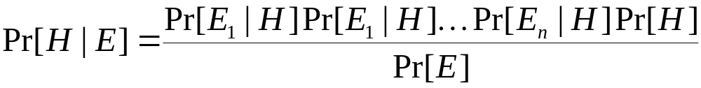
Naïve Bayes for classification
Classification learning: what’s the probability of the class given an instance?
  Evidence E = instance
  Event H = class value for instance
Naïve assumption: evidence splits into parts (i.e. attributes) that are independent
witten&eibe

Slide 18



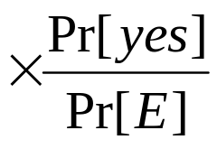
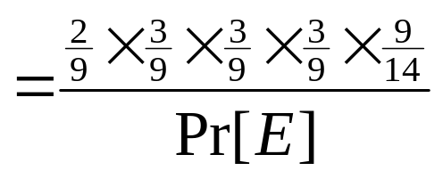
Weather data example
Outlook | Temp. | Humidity | Windy | Play
Sunny | Cool | High | True | ?
Evidence E
Probability of
class “yes”
witten&eibe

Slide 19


The “zero-frequency problem”
What if an attribute value doesn’t occur with every class value?
(e.g. “Humidity = high” for class “yes”)
  Probability will be zero!
  A posteriori probability will also be zero!
  (No matter how likely the other values are!)
Remedy: add 1 to the count for every attribute value-class combination (Laplace estimator)
Result: probabilities will never be zero!
(also: stabilizes probability estimates)
witten&eibe

Slide 20
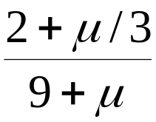
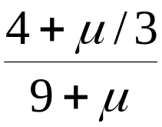
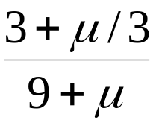
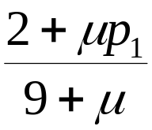
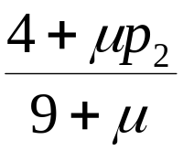
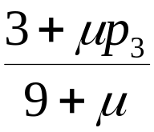
*Modified probability estimates
In some cases adding a constant different from 1 might be more appropriate
Example: attribute outlook for class yes
Weights don’t need to be equal
(but they must sum to 1)
Sunny
Overcast
Rainy
witten&eibe

Slide 21
Missing values
Training: instance is not included in frequency count for attribute value-class combination
Classification: attribute will be omitted from calculation
Example:
Outlook | Temp. | Humidity | Windy | Play
? | Cool | High | True | ?
Likelihood of “yes” = 3/9 × 3/9 × 3/9 × 9/14 = 0.0238 Likelihood of “no” = 1/5 × 4/5 × 3/5 × 5/14 = 0.0343 P(“yes”) = 0.0238 / (0.0238 + 0.0343) = 41% P(“no”) = 0.0343 / (0.0238 + 0.0343) = 59%
witten&eibe

Slide 22
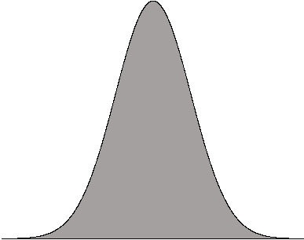
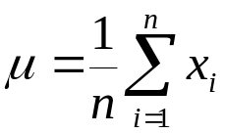
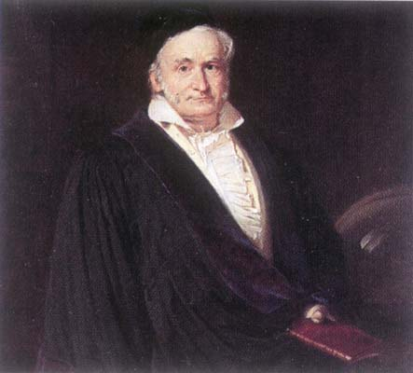
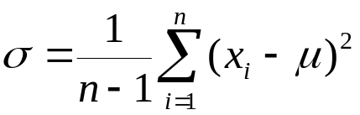
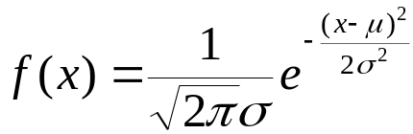
Numeric attributes
Usual assumption: attributes have a normal or Gaussian probability distribution (given the class)
The probability density function for the normal distribution is defined by two parameters:
  Sample mean μ
  Standard deviation σ
  Then the density function f(x) is
Karl Gauss, 1777-1855
great German mathematician
witten&eibe

Slide 23
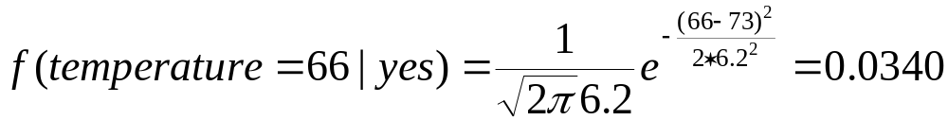
Statistics for weather data
Outlook |  |  | Temperature |  |  | Humidity |  |  | Windy |  |  | Play
 | Yes | No |  | Yes | No |  | Yes | No |  | Yes | No | Yes | No
Sunny | 2 | 3 |  | 64, 68, | 65, 71, |  | 65, 70, | 70, 85, | False | 6 | 2 | 9 | 5
Overcast | 4 | 0 |  | 69, 70, | 72, 80, |  | 70, 75, | 90, 91, | True | 3 | 3
Rainy | 3 | 2 |  | 72, … | 85, … |  | 80, … | 95, …
Sunny | 2/9 | 3/5 |  | μ =73 | μ =75 |  | μ =79 | μ =86 | False | 6/9 | 2/5 | 9/14 | 5/14
Overcast | 4/9 | 0/5 |  | σ =6.2 | σ =7.9 |  | σ =10.2 | σ =9.7 | True | 3/9 | 3/5
Rainy | 3/9 | 2/5
Example density value:
witten&eibe

Slide 24
Classifying a new day
A new day:
Missing values during training are not included in calculation of mean and standard deviation
Outlook | Temp. | Humidity | Windy | Play
Sunny | 66 | 90 | true | ?
Likelihood of “yes” = 2/9 × 0.0340 × 0.0221 × 3/9 × 9/14 = 0.000036 Likelihood of “no” = 3/5 × 0.0291 × 0.0380 × 3/5 × 5/14 = 0.000136 P(“yes”) = 0.000036 / (0.000036 + 0. 000136) = 20.9% P(“no”) = 0.000136 / (0.000036 + 0. 000136) = 79.1%
witten&eibe

Slide 25
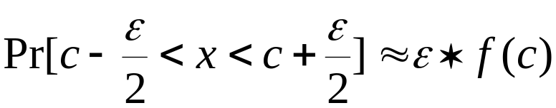
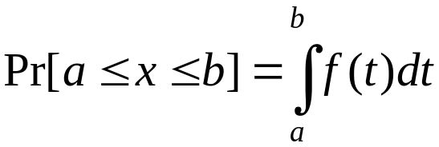
*Probability densities
Relationship between probability and density:
But: this doesn’t change calculation of a posteriori probabilities because ε cancels out
Exact relationship:
witten&eibe

Slide 26
Naïve Bayes: discussion
Naïve Bayes works surprisingly well (even if independence assumption is clearly violated)
Why? Because classification doesn’t require accurate probability estimates as long as maximum probability is assigned to correct class
However: adding too many redundant attributes will cause problems (e.g. identical attributes)
Note also: many numeric attributes are not normally distributed (→ kernel density estimators)
witten&eibe

Slide 27
Naïve Bayes Extensions
Improvements:
  select best attributes (e.g. with greedy search)
  often works as well or better with just a fraction of all attributes
Bayesian Networks
witten&eibe

Slide 28
Summary
OneR – uses rules based on just one attribute
Naïve Bayes – use all attributes and Bayes rules to estimate probability of the class given an instance.
Simple methods frequently work well, but …
  Complex methods can be better (as we will see)

